Slide 1
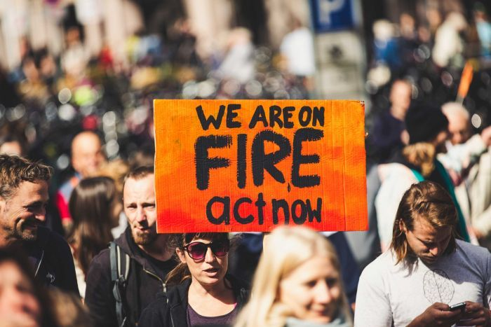
GLOBAL CHANGE, TIPPING POINTS
AND HOTHOUSE EARTH
Will Steffen
Australian National University
ABC News

Slide 2
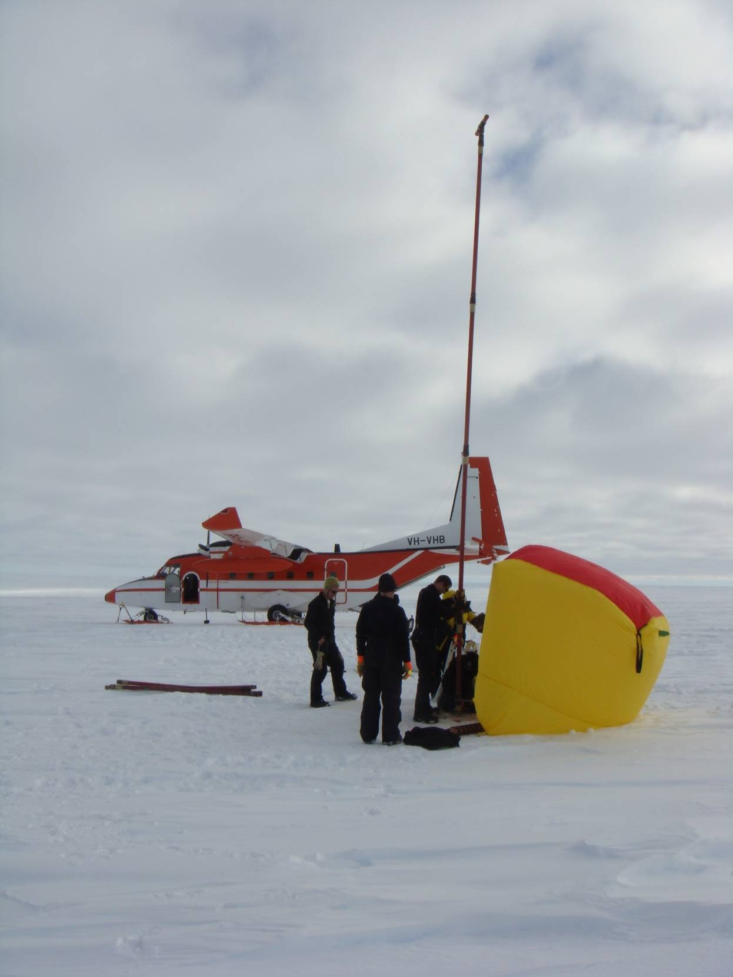
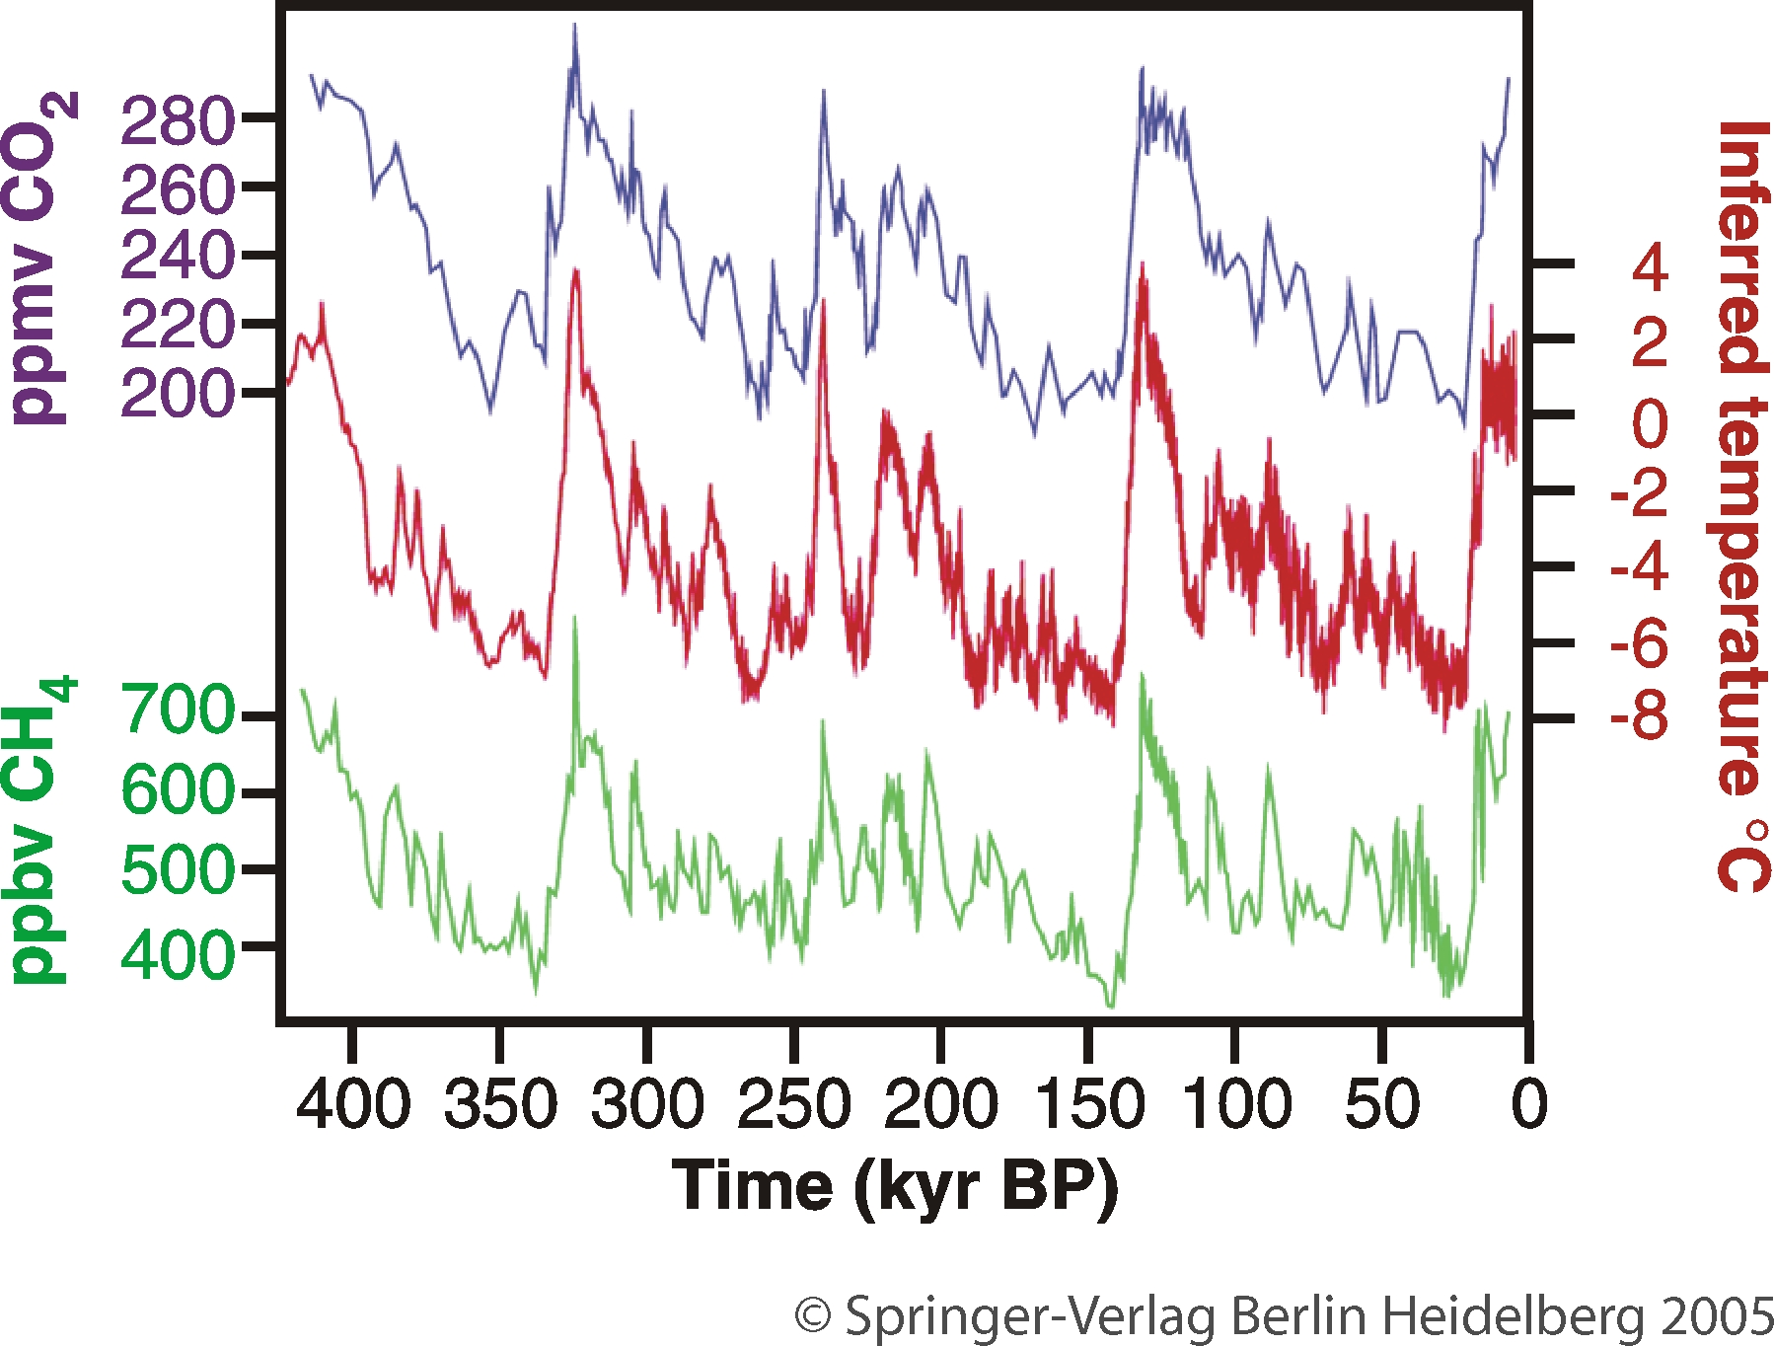
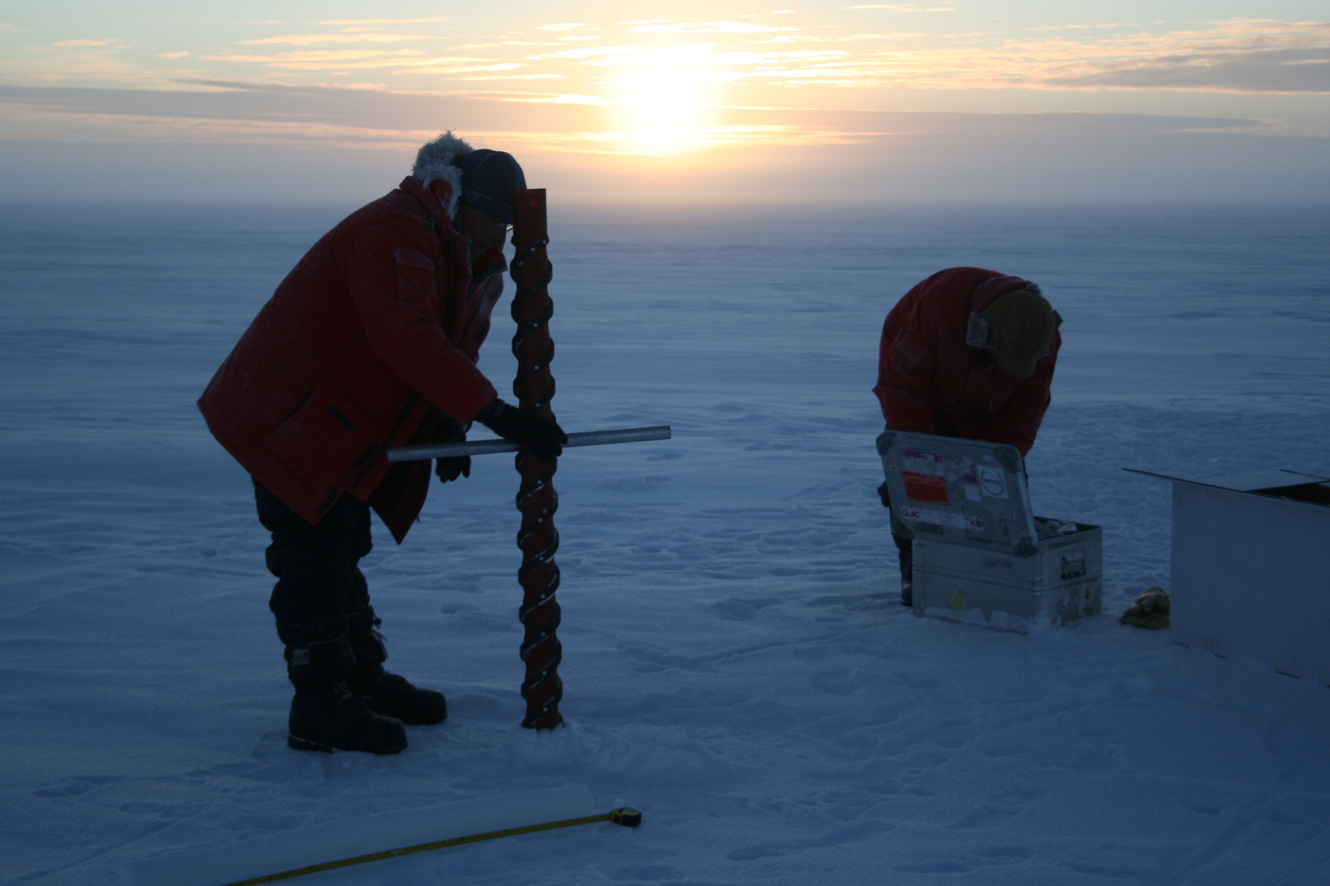
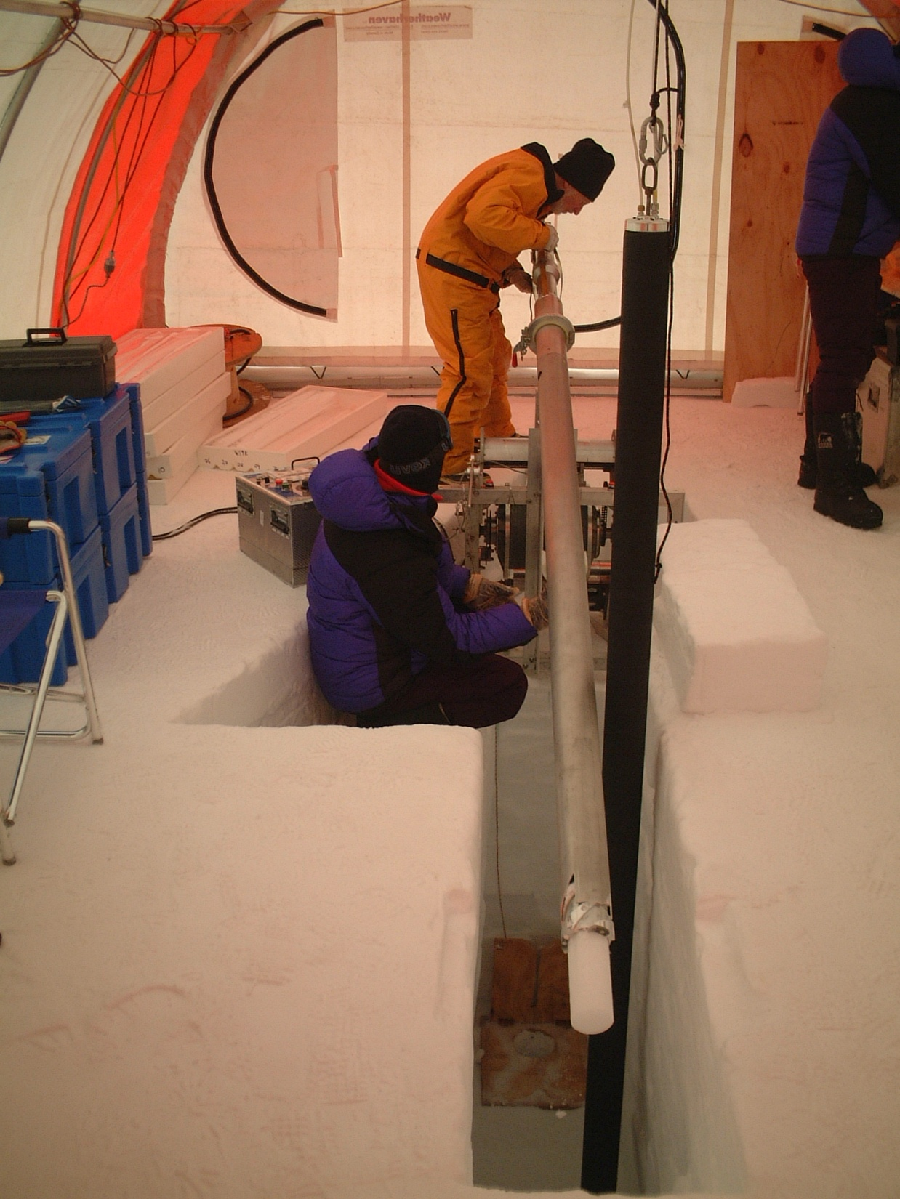
Human Development
and
the Earth System
Beginning of agriculture
Evolution of fully modern
humans in Africa
Hunter-gatherer
societies only
Adapted from Steffen et al. 2004; ice core data from Petit et al. 1999

Slide 3
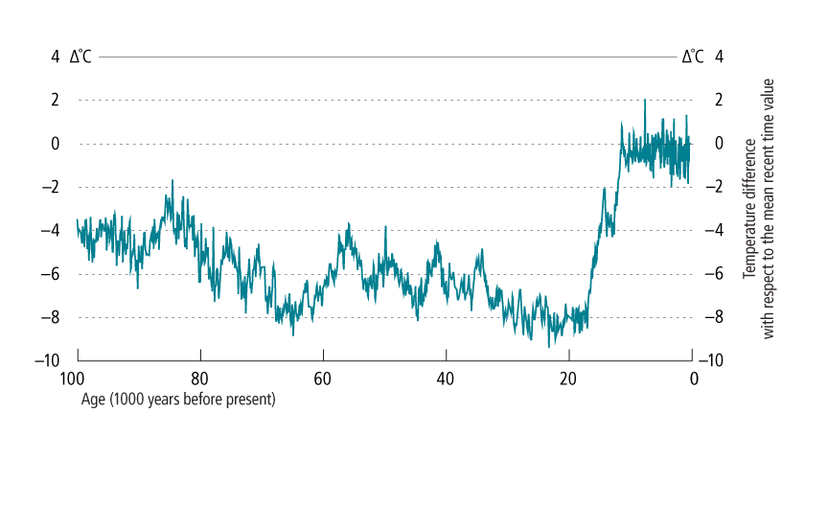
The Holocene Reference Point
Source: Data from Petit et al. 1999, labeled as in Young and Steffen 2009.
Source: J. Rockström and N. Nakicenovic
Data from Petit et al. 1999 and Oppenheimer 2004

Slide 4
Observed increase in global temperature
WMO 2020

Slide 5
Rates of Change
Rate of atmospheric CO₂ increase over the past two
decades is about 100 times the maximum rate during
the last deglaciation.
Since 1970 the global average temperature has risen at
a rate about 170 times the background rate over the
past 7,000 years of the Holocene, and in the opposite
direction.
De Vos et al. 2014; Wolff 2011; Marcott et al. 2013; NOAA 2016; Canfield et al. 2010

Slide 6
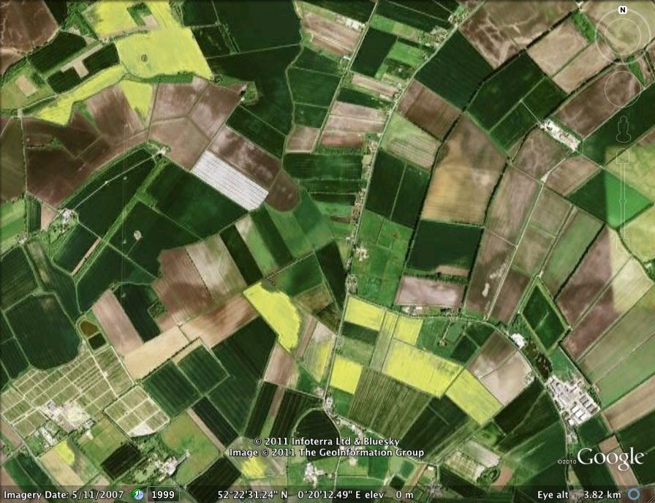
Human Transformation of
the Biosphere

Slide 7
Nature’s Dangerous Decline
Nature is declining globally at rates unprecedented
In human history
Around 1 million animal and plant species are now threatened
with extinction, many within decades.
The web of life on Earth is getting smaller and increasingly frayed.
Intergovernmental Science-Policy Platform on Biodiversity and Ecosystem Services, 2019

Slide 8
Global homogenisation of flora and fauna
Homo sapiens comandeering 25-40% of NPP
and mining fossil NPP
Human-directed evolution of other species
Increasing interaction of the biosphere with the
technosphere
Signs of a New, Third Stage of
Biosphere Evolution

Slide 9
Observed increase in global temperature
WMO 2020

Slide 10
Temperature rise: Beyond the envelope of natural variability!
An Earth System Perspective
Human influence
Summerhayes 2015

Slide 11
Implications of accelerating climate change
IPCC temperature projections
IPCC 2013

Slide 12
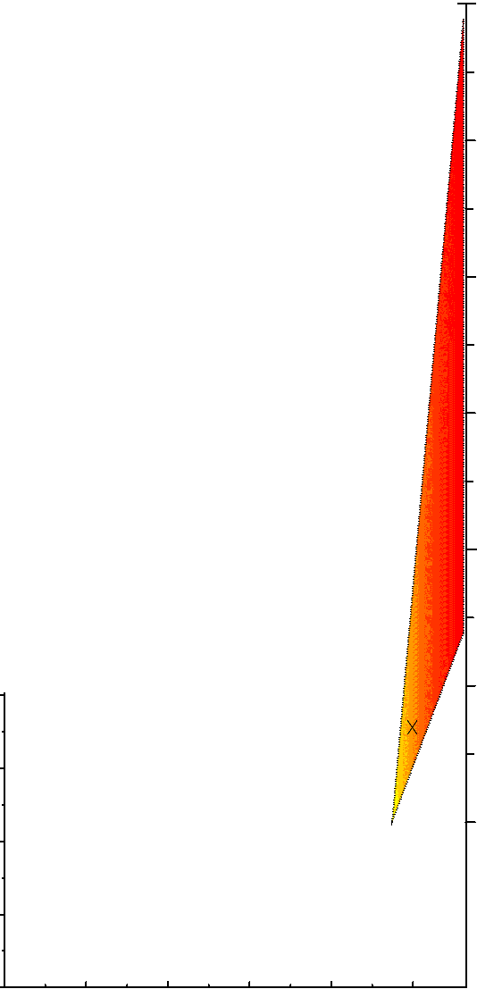
6
Earth System moves to a new
state? Severe challenge to
contemporary civilisation.
Possible collapse?
5
IPCC Projections
2100 AD
4
Current trajectory
3
Global Temperature (°C)
Tipping Points?
2
Paris targets
1
0
Summerhayes 2015

Slide 13
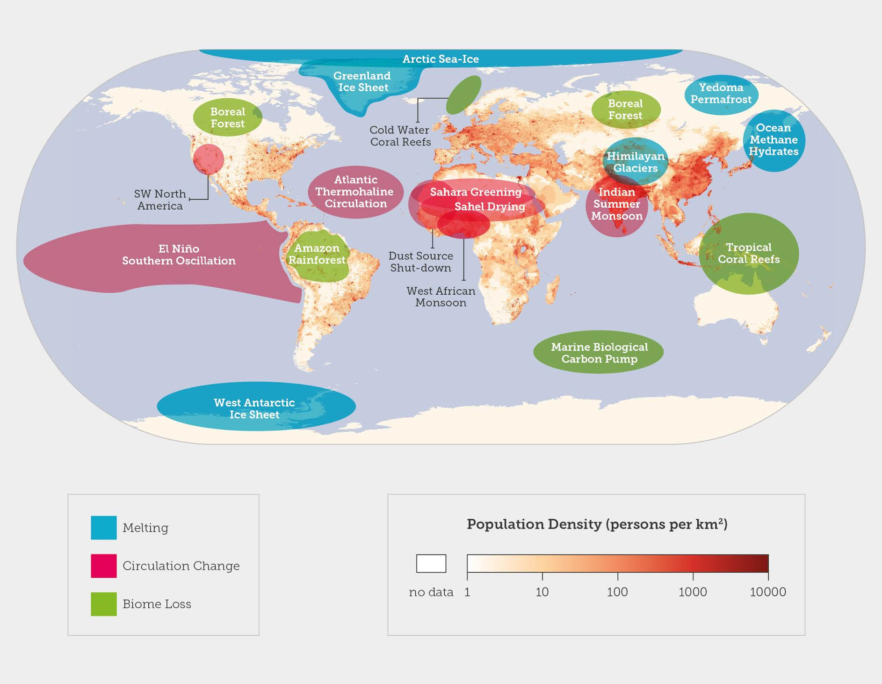
Tipping Elements in the Earth System
Huber, Lenton, and Schellnhuber, in Richardson et al. 2011

Slide 14
The Amazon tipping element
50%
50%
Amazon forest
Savanna
Dry forest
Dieback
Fire
Ocean
Climate change: change
in ocean/atmos circulation
reduced rainfall;
increased drought
Deforestation: conversion
to cropland or pasture
reduced evaporation and
water recycling

Slide 15
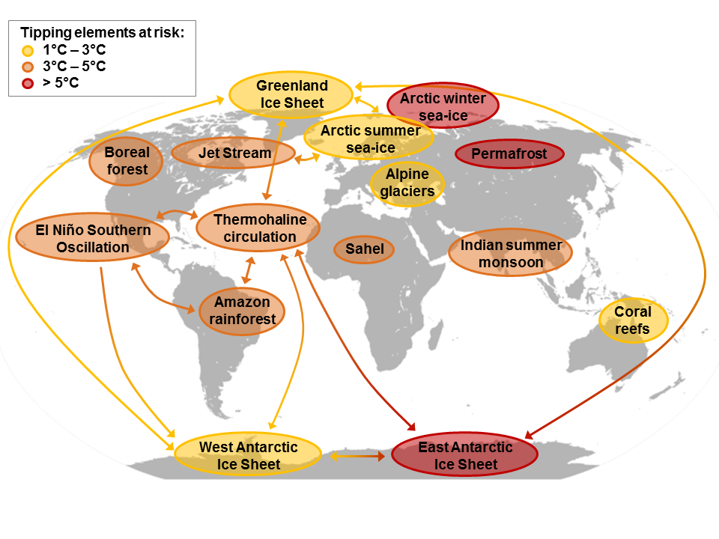
Tipping Cascades
Moderate risk of ‘large scale singular events’ (e.g., tipping
points) at 1ºC and moderate-high risk at 2.5ºC of warming
IPCC SR1.5 (2018)
Source: J. Donges and R. Winkelmann
in Steffen et al. 2018

Slide 16
Global Tipping Cascade
“If damaging tipping cascades can occur and a global
tipping point cannot be ruled out, then this is an
existential threat to civilization. No amount of economic
cost-benefit analysis is going to help us.”
Lenton et al. 2019

Slide 17
Earth System Trajectories
Paris climate
targets;
Biosphere
restoration
Current
Trajectory
Tipping
Cascade
Steffen et al. 2018

